Slide 1
MVPs: Business Logic Plugins and Agentic AI
2-26-2025

Slide 2
"Big Picture"
Show that HSML can serve as a common language, for use in interoperability between 3D modeling software suites

Slide 3

Business Logic Plugins

Slide 4
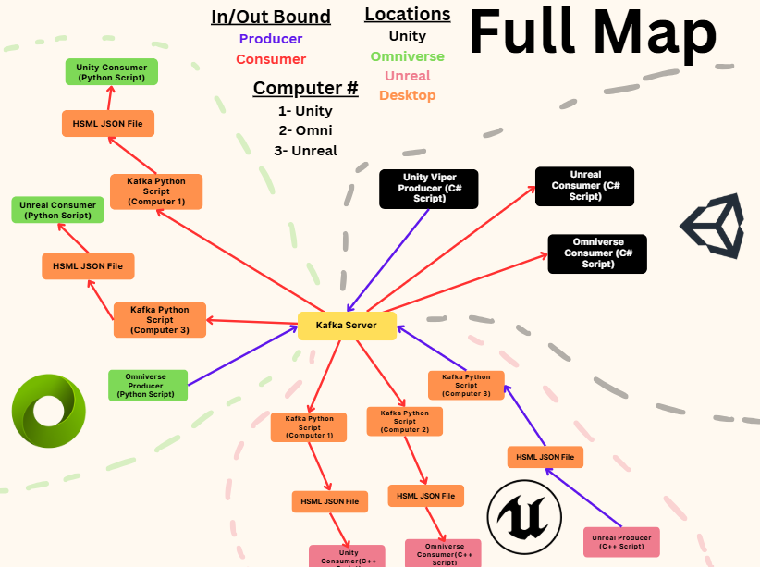

Slide 5
Option 1: AI used to convert HSML, producer/consumer logic remains the same

Slide 6
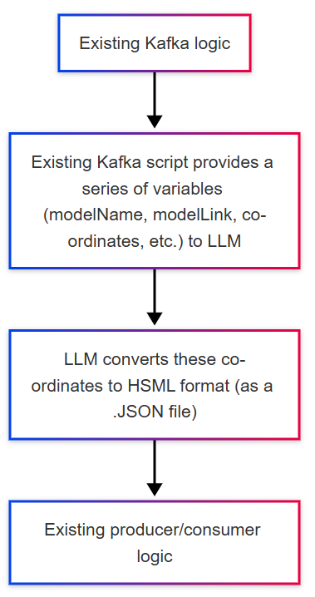

Slide 7


LLM converts to HSML with provided variables

Slide 8
Pros:
Cons:
Proves LLM/AI can be used to convert into new digital standard language (HSML)
Easiest way of implementing AI into existing work without getting "into the weeds" of individual software quirks
Does not easily extend to new platforms; each new system (ex. TINA) would need to be have manually coded producer/consumer scripts

Slide 9
Option 2: AI used to add new objects to scene, existing producer/consumer logic maintained

Slide 10
Option 2
New objects are currently not tracked, and require new code to be tracked
AI can be used to intelligently add new objects to the shared workflow

Slide 11
Pros:
Cons:
Meets our "Big Picture" goal of using AI to reduce code needed for engineers to use our product
A small step forward, but not the giant leap we're hoping for

Slide 12
Option 3: Something else

Slide 13

Pause for commentary/questions

Slide 14
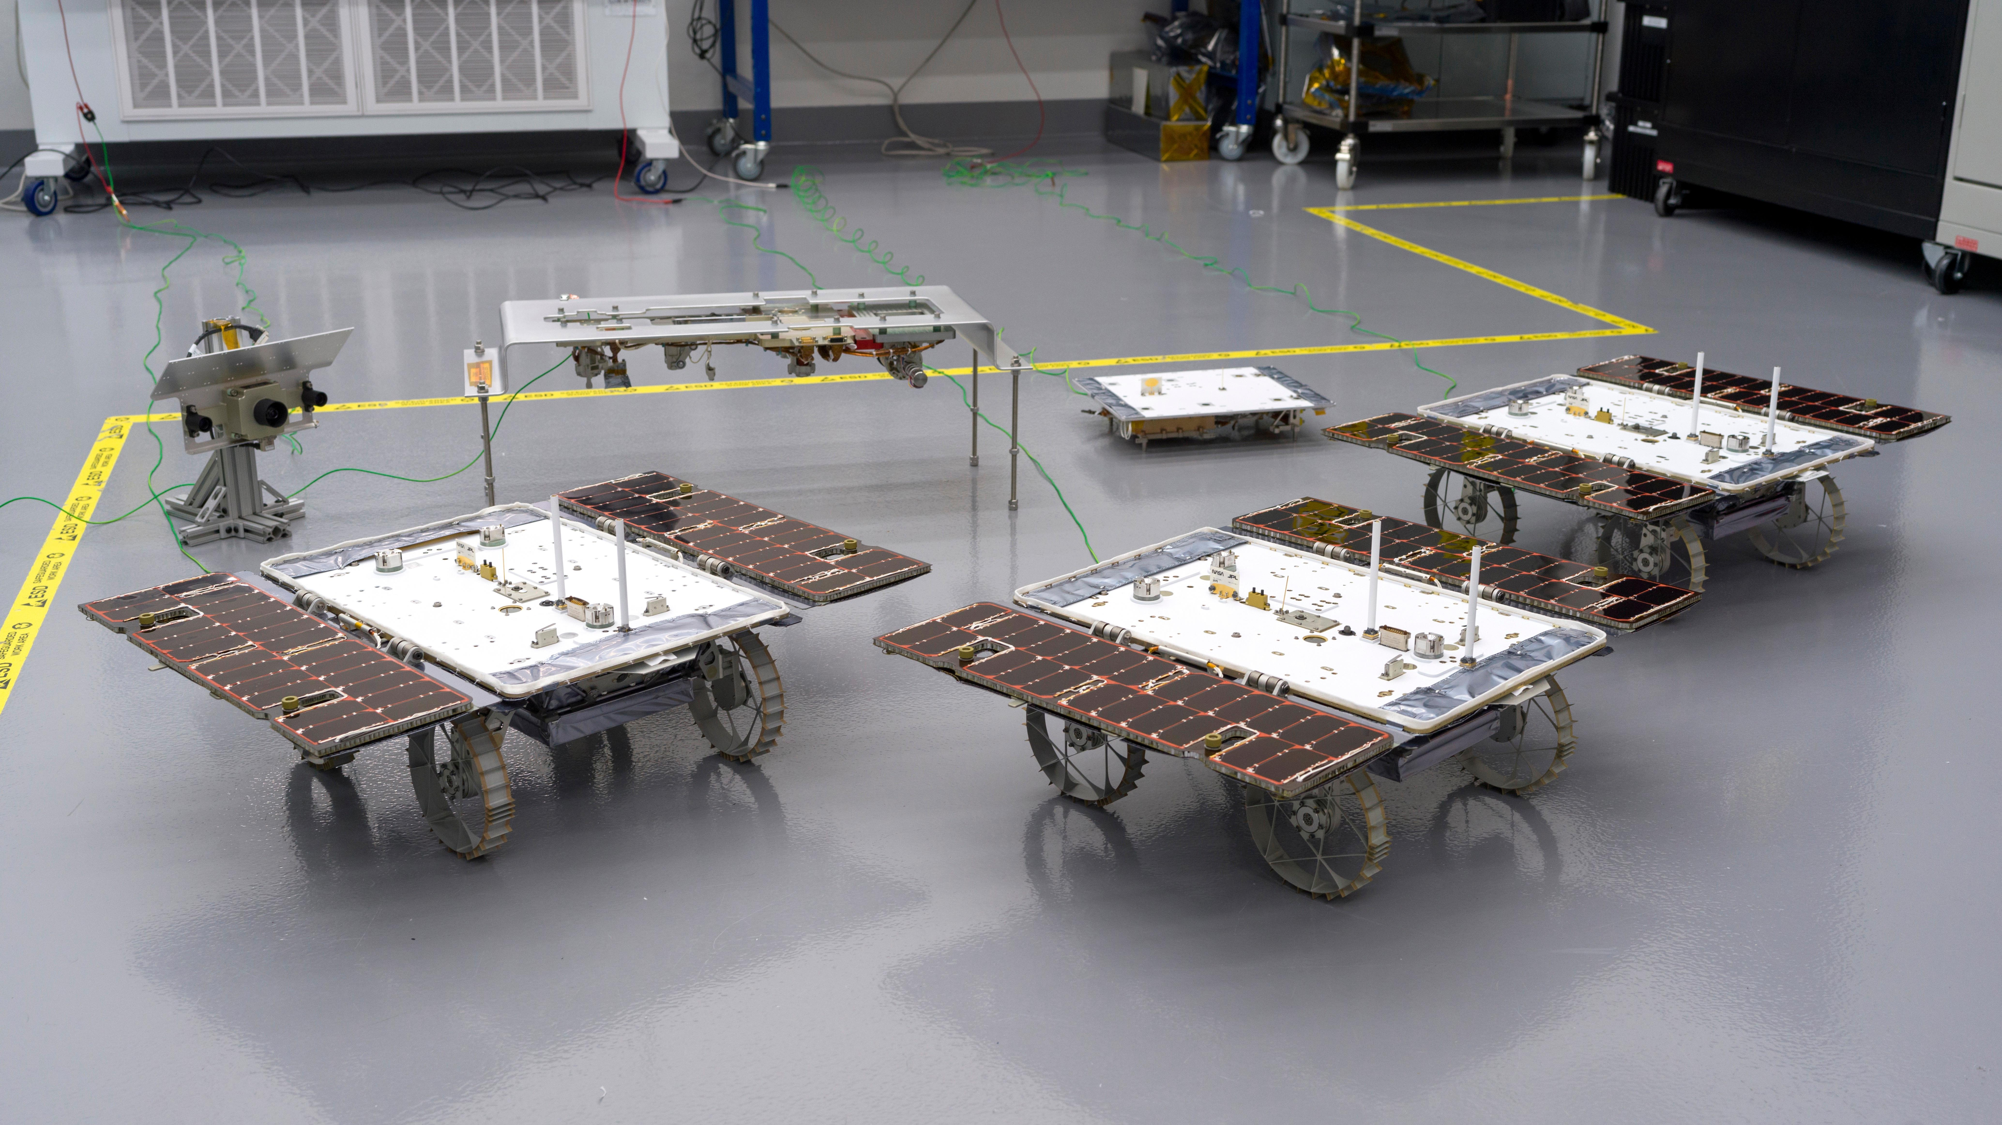
Agentic AI Rover

Slide 15
Minimum Viable Product
Assumptions: Rover already knows the best possible path (no calling Chronos/PINN)
Extremely simplistic vision-to-text-to-function model

Slide 16
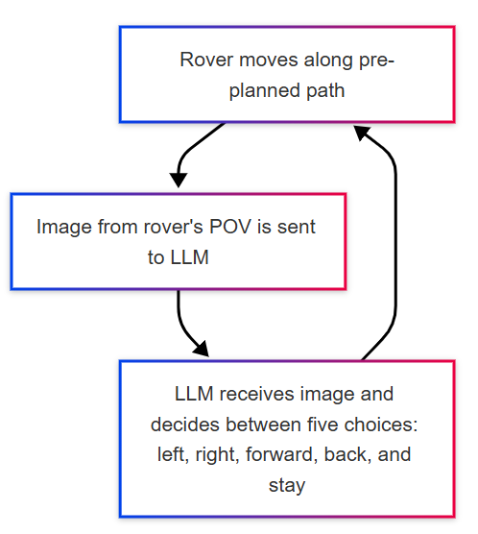

Slide 17
Stretch Goal
Use PINN (avoid Chronos) to plan a route where no angle is greater than 33 degrees (to avoid Chronos)
Integrate an old intern's path planning software (or spin up our own)

Slide 18
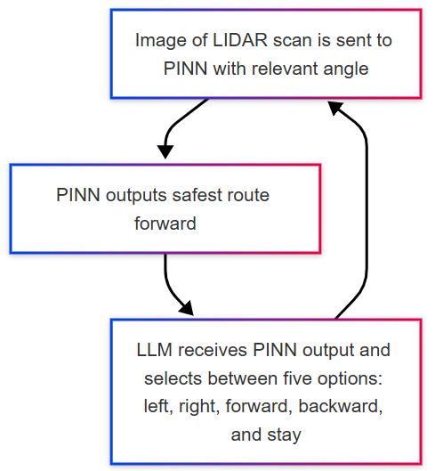

Slide 19
Housekeeping/Misc.
Meeting with Gautier Monday, re: PINN/Chronos
Working on seeing if we can get two extra laptops with a GPU for SIRI interns (no promises)

Slide 20

Unused Slides

Slide 21
Minimum Viable Product (MVP)
Input:
Currently used system (ex. Unity, Unreal, Omniverse)
Attributes: schema_id, modelName, modelNumber, objectLink, creatorName, creationDate, modifiedDate, x, y, z, rx, ry, rz, w
Output:
HSML

Slide 22
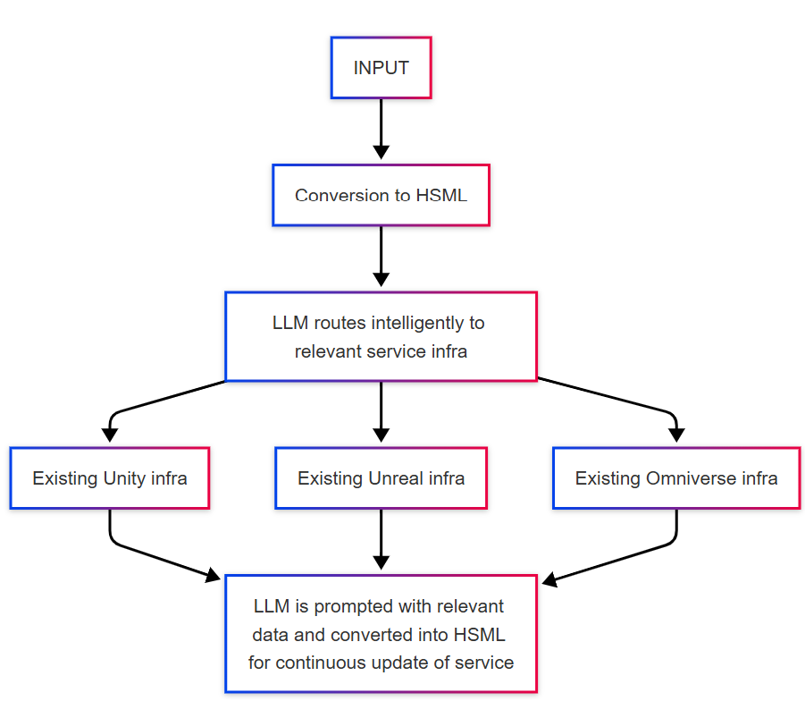

Slide 23
Issues
Not very robust – manual coding is required to create plugins for each piece of software to receive and translate the HSML
Ongoing work: minimizing HSML needed to pass in updates
Learning curve: each piece of software has it's own arbitrary restrictions/required workarounds (see Jared's work) that will need to be accounted for

Slide 24
Stretch Goal
A solution that more intelligently takes input and enables interoperability with minimal or no coding required for "producer" or "consumer"
Likely an ongoing effort

Slide 25
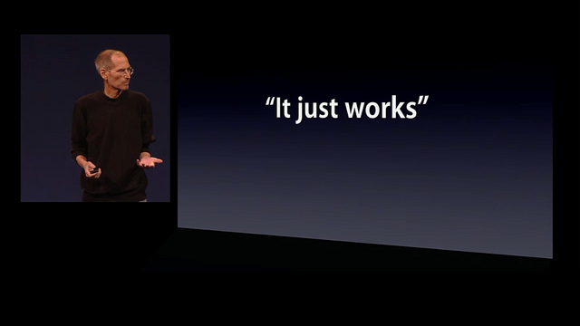

Slide 26
"Big Picture"
A simple, easy-to-use interface for engineers to collaborate with one another across platforms
Low or no-code required from the engineer

